Slide 2
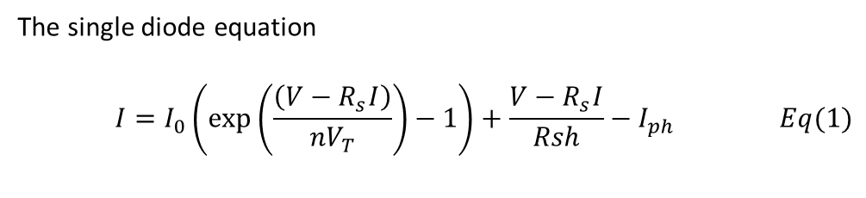
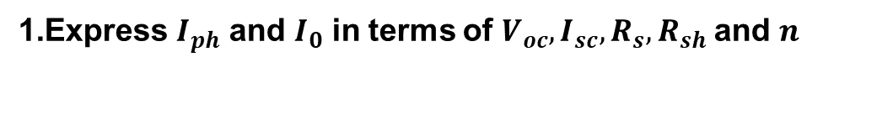
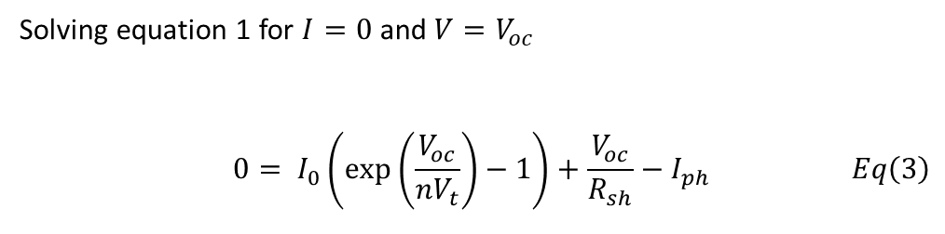
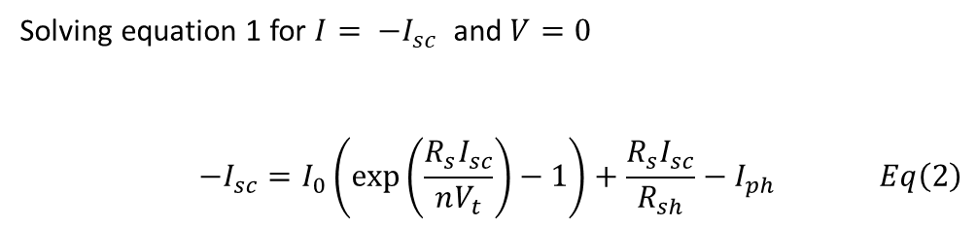
Theory
Express $I_{ph}$ and $I_{0}$ in terms of $V_{oc}, I_{sc}, R_{s},R_{sh}$and $n$
The single diode equation
$$\begin{aligned}I=I_{0}\left(\exp\left(\frac{\left(V−R_{s}I\right)}{nV_{T}}\right)−1\right)+\frac{V−R_{s}I}{Rsh}−I_{ph} \#Eq(1)\end{aligned}$$
Solving equation 1 for $I= −I_{sc}$ and $V=0$
$$\begin{aligned}−I_{sc}=I_{0}\left(\exp\left(\frac{R_{s}I_{sc}}{nV_{t}}\right)−1\right)+\frac{R_{s}I_{sc}}{R_{sh}}−I_{ph} \#Eq\left(2\right)\end{aligned}$$
Solving equation 1 for $I=0$ and $V=V_{oc}$
$$\begin{aligned}0= I_{0}\left(\exp\left(\frac{V_{oc}}{nV_{t}}\right)−1\right)+\frac{V_{oc}}{R_{sh}}−I_{ph} \#Eq\left(3\right)\end{aligned}$$

Slide 3

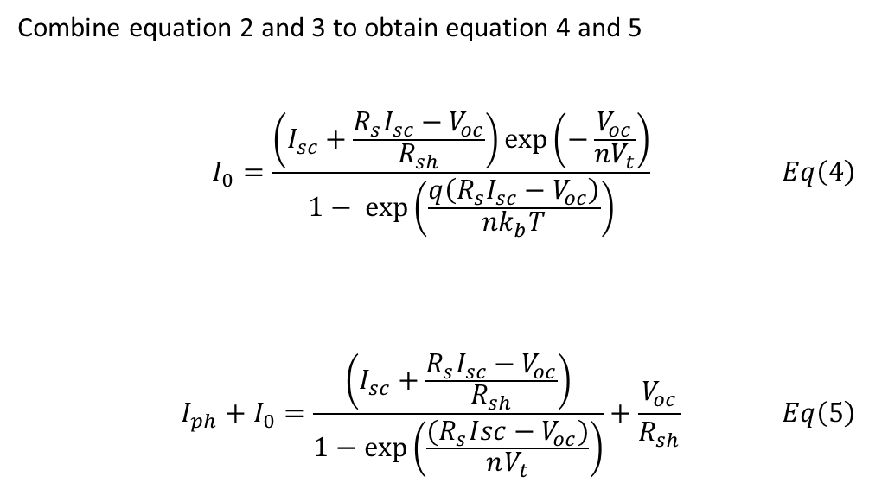
Combine equation 2 and 3 to obtain equation 4 and 5
$$\begin{aligned}I_{0}=\frac{\left(I_{sc}+\frac{R_{s}I_{sc}−V_{oc}}{R_{sh}}\right)\exp\left(−\frac{V_{oc}}{nV_{t}}\right)}{1− \exp\left(\frac{q\left(R_{s}I_{sc}−V_{oc}\right)}{nk_{b}T}\right)} \#Eq\left(4\right)\end{aligned}$$
$$\begin{aligned}I_{ph}+I_{0}=\frac{\left(I_{sc}+\frac{R_{s}I_{sc}−V_{oc}}{R_{sh}}\right)}{1−\exp\left(\frac{{(R}_{s}Isc−V_{oc})}{nV_{t}}\right)}+\frac{V_{oc}}{R_{sh}} \#Eq\left(5\right)\end{aligned}$$
If the term $$\begin{aligned}\exp\left(\frac{q\left(R_{s}I_{sc}−V_{oc}\right)}{nk_{b}T}\right)≪1 \end{aligned}$$
Equation 5 can be reduced to
$$\begin{aligned}I_{ph}+I_{0}=I_{sc}+\frac{R_{s}I_{sc}}{R_{sh}} \#Eq\left(6\right)\end{aligned}$$

Slide 4
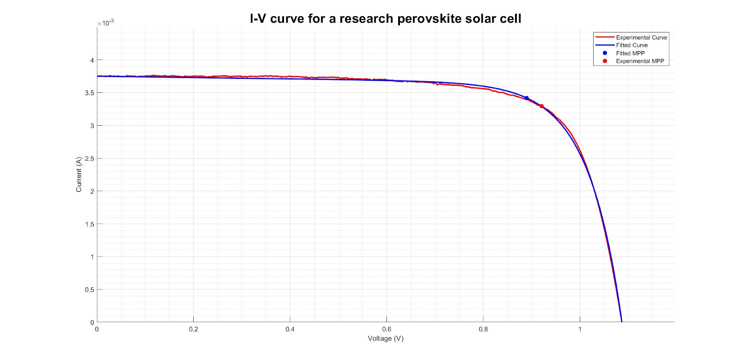
What is the problem?
Extracted Parameters
Rs (Ω) | Rsh (kΩ) | n
-1.28 | 10.00 | 2.88

Slide 5
Problem Statement
Current models for characterization are not reliable enough for high throughput characterization
Negative parameters
Initial guesses in literature are not applicable for all I-V data curves
Too far from the actual solution
Undefined at initial guess
Non realistic parameters extracted
Solutions to these problems mean
More reliable parameter
Help understand the issue causing low fill factor

Slide 6
Possible Solution
Use trust region method
Apply constraints
Constraints derived from assuming one parameter influences the shape of the curve

Slide 7
Objectives
Investigate the ability to extract accurate and sensible $R_{s},R_{sh}$and $n$ for different IV data

Slide 8
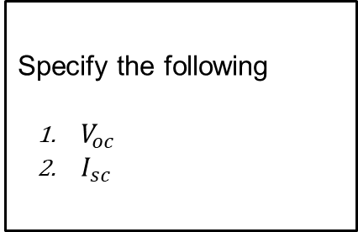
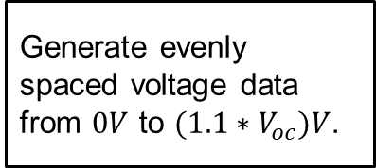
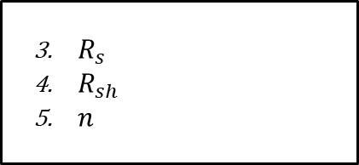
Simulate IV data
Specify the following
$V_{oc}$
$I_{sc}$
Introduce noise with signal to noise ratio (SR) of 45
Generate evenly spaced voltage data from $0V$ to $(1.1∗V_{oc})V$.
Generate current with explicit single diode equation.
$R_{s}$
$R_{sh}$
$n$

Slide 9
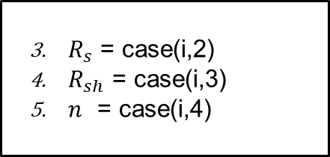
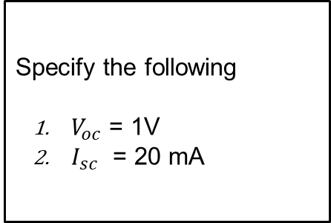
Simulated cases
Case | Rs (Ω) | Rsh (kΩ) | n
1 | 0.10 | 1.00E+03 | 1.00
2 | 25.00 | 1.00E+03 | 1.00
3 | 0.10 | 0.20 | 1.00
4 | 0.10 | 1.00E+03 | 2.50
5 | 25.00 | 1.00E+03 | 2.50
6 | 0.10 | 0.2 | 2.50
7 | 0.10 | 1.00E+03 | 5.00
8 | 25.00 | 0.2 | 5.00
Specify the following
$V_{oc}$ = 1V
$I_{sc}$ = 20 mA
$R_{s}$ = case(i,2)
$R_{sh}$ = case(i,3)
$n$ = case(i,4)

Slide 10
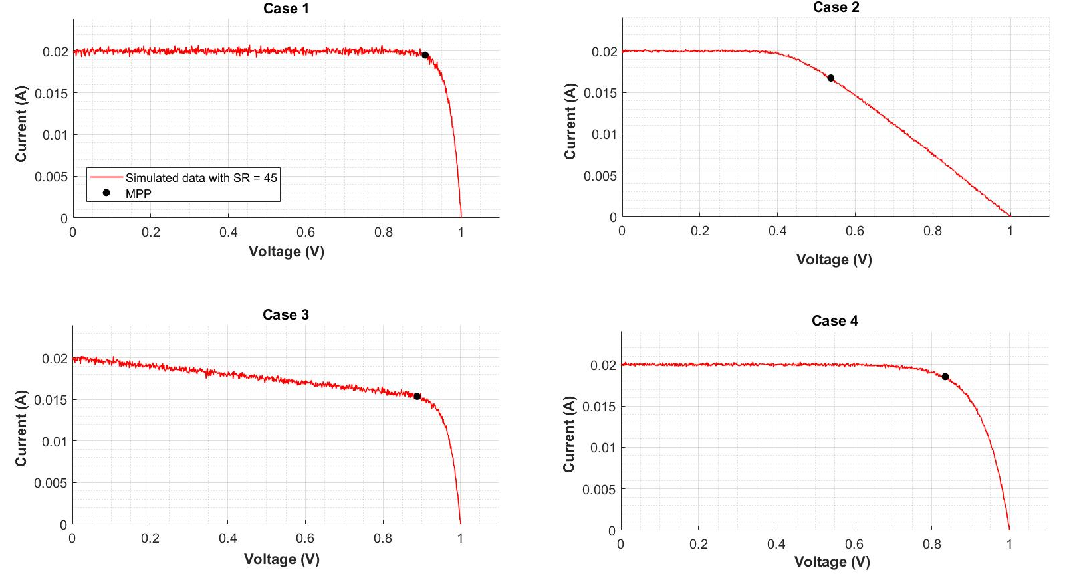
Simulated cases 1 - 4

Slide 11
Simulated cases 5 - 8

Slide 12
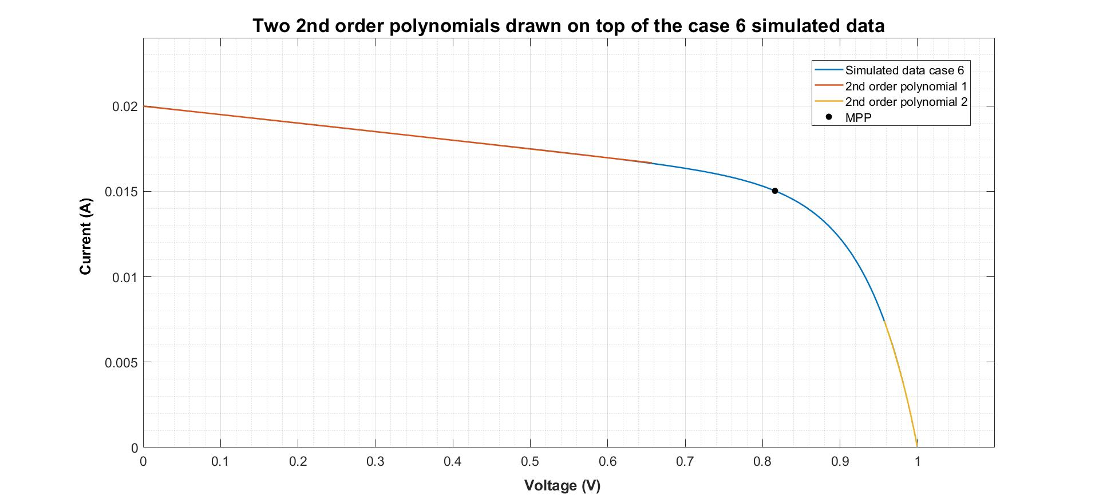


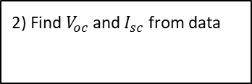
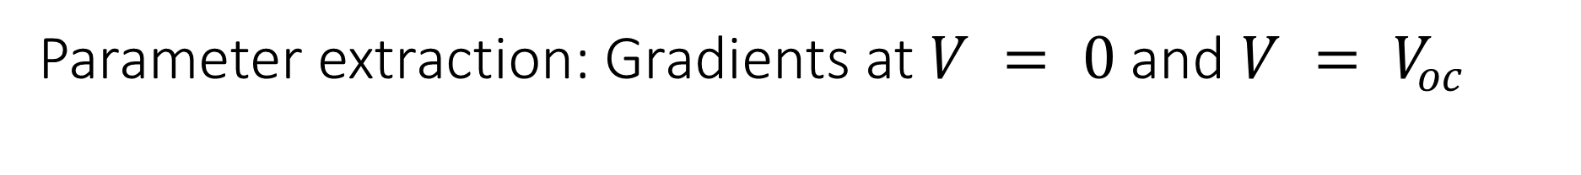
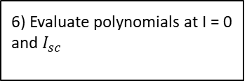

Parameter extraction: Gradients at $V = 0$and $V = V_{oc}$
1) Smooth current data
2) Find $V_{oc}$ and $I_{sc}$ from data
3) Find $V_{m}$ and $I_{m}$
4) Fit data with two 2nd order polynomials
5) Differentiate 2nd order polynomial
6) Evaluate polynomials at I = 0 and $I_{sc}$

Slide 13
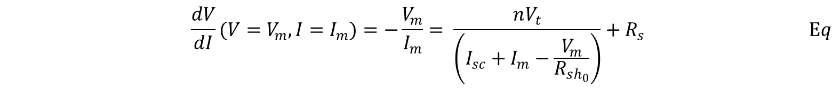
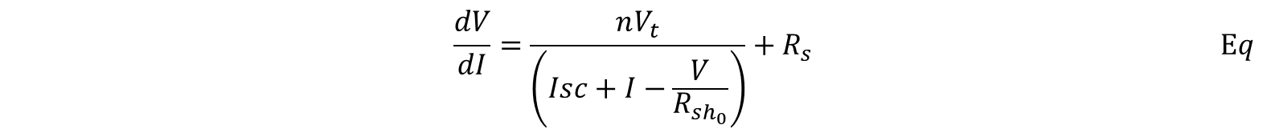
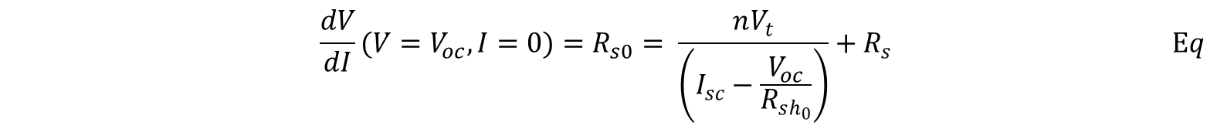
Parameter extraction: Initial guesses
$$\begin{aligned}&\frac{dV}{dI}=\frac{nV_{t}}{\left(Isc+I−\frac{V}{R_{sh_{0}}}\right)}+R_{s}\#\#Eq\end{aligned}$$
$$\begin{aligned}&\frac{dV}{dI}(V=V_{m}, I=I_{m})=−\frac{V_{m}}{I_{m}}= \frac{nV_{t}}{\left(I_{sc}+I_{m}−\frac{V_{m}}{R_{sh_{0}}}\right)}+R_{s }\#\#Eq\end{aligned}$$
$$\begin{aligned}&\frac{dV}{dI}(V=V_{oc}, I=0)=R_{s0}= \frac{nV_{t}}{\left(I_{sc}−\frac{V_{oc}}{R_{sh_{0}}}\right)}+R_{s }\#\#Eq\end{aligned}$$

Slide 14
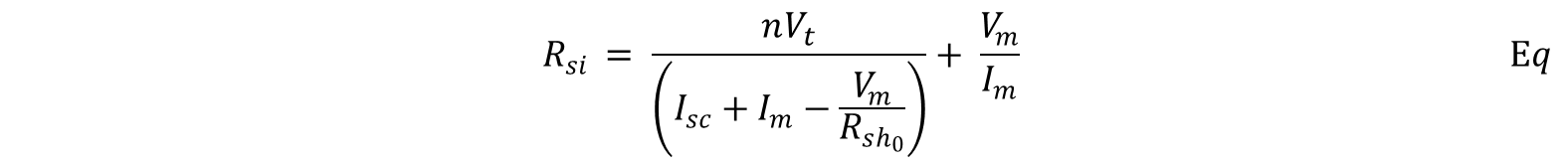
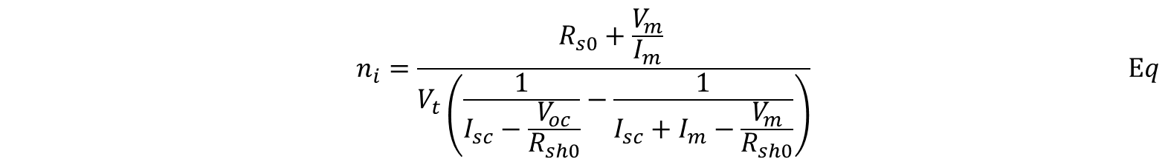
Equation 6 and 5 can be subtracted to obtain $n$ to as function of known parameters.
$$\begin{aligned}&n_{i}=\frac{R_{s0}+\frac{V_{m}}{I_{m}} }{V_{t}\left(\frac{1}{I_{sc}−\frac{V_{oc}}{R_{sh0}}}−\frac{1}{I_{sc}+I_{m}−\frac{V_{m}}{R_{sh0}}}\right)}\#\#Eq\end{aligned}$$
$Rs$ can be retrieved by substituting the calculated in $n$ into equation (5). Equation (5) has been rearranged below to make $Rs$ as the subject of the formula.
$$\begin{aligned}&R_{si }= \frac{nV_{t}}{\left(I_{sc}+I_{m}−\frac{V_{m}}{R_{sh_{0}}}\right)}+ \frac{V_{m}}{I_{m}}\#\#Eq\end{aligned}$$
$$\begin{aligned}&R_{shi }=R_{sh0 }\#\#Eq\end{aligned}$$

Slide 15
Parameter extraction: Solver Setting

